Slide 1

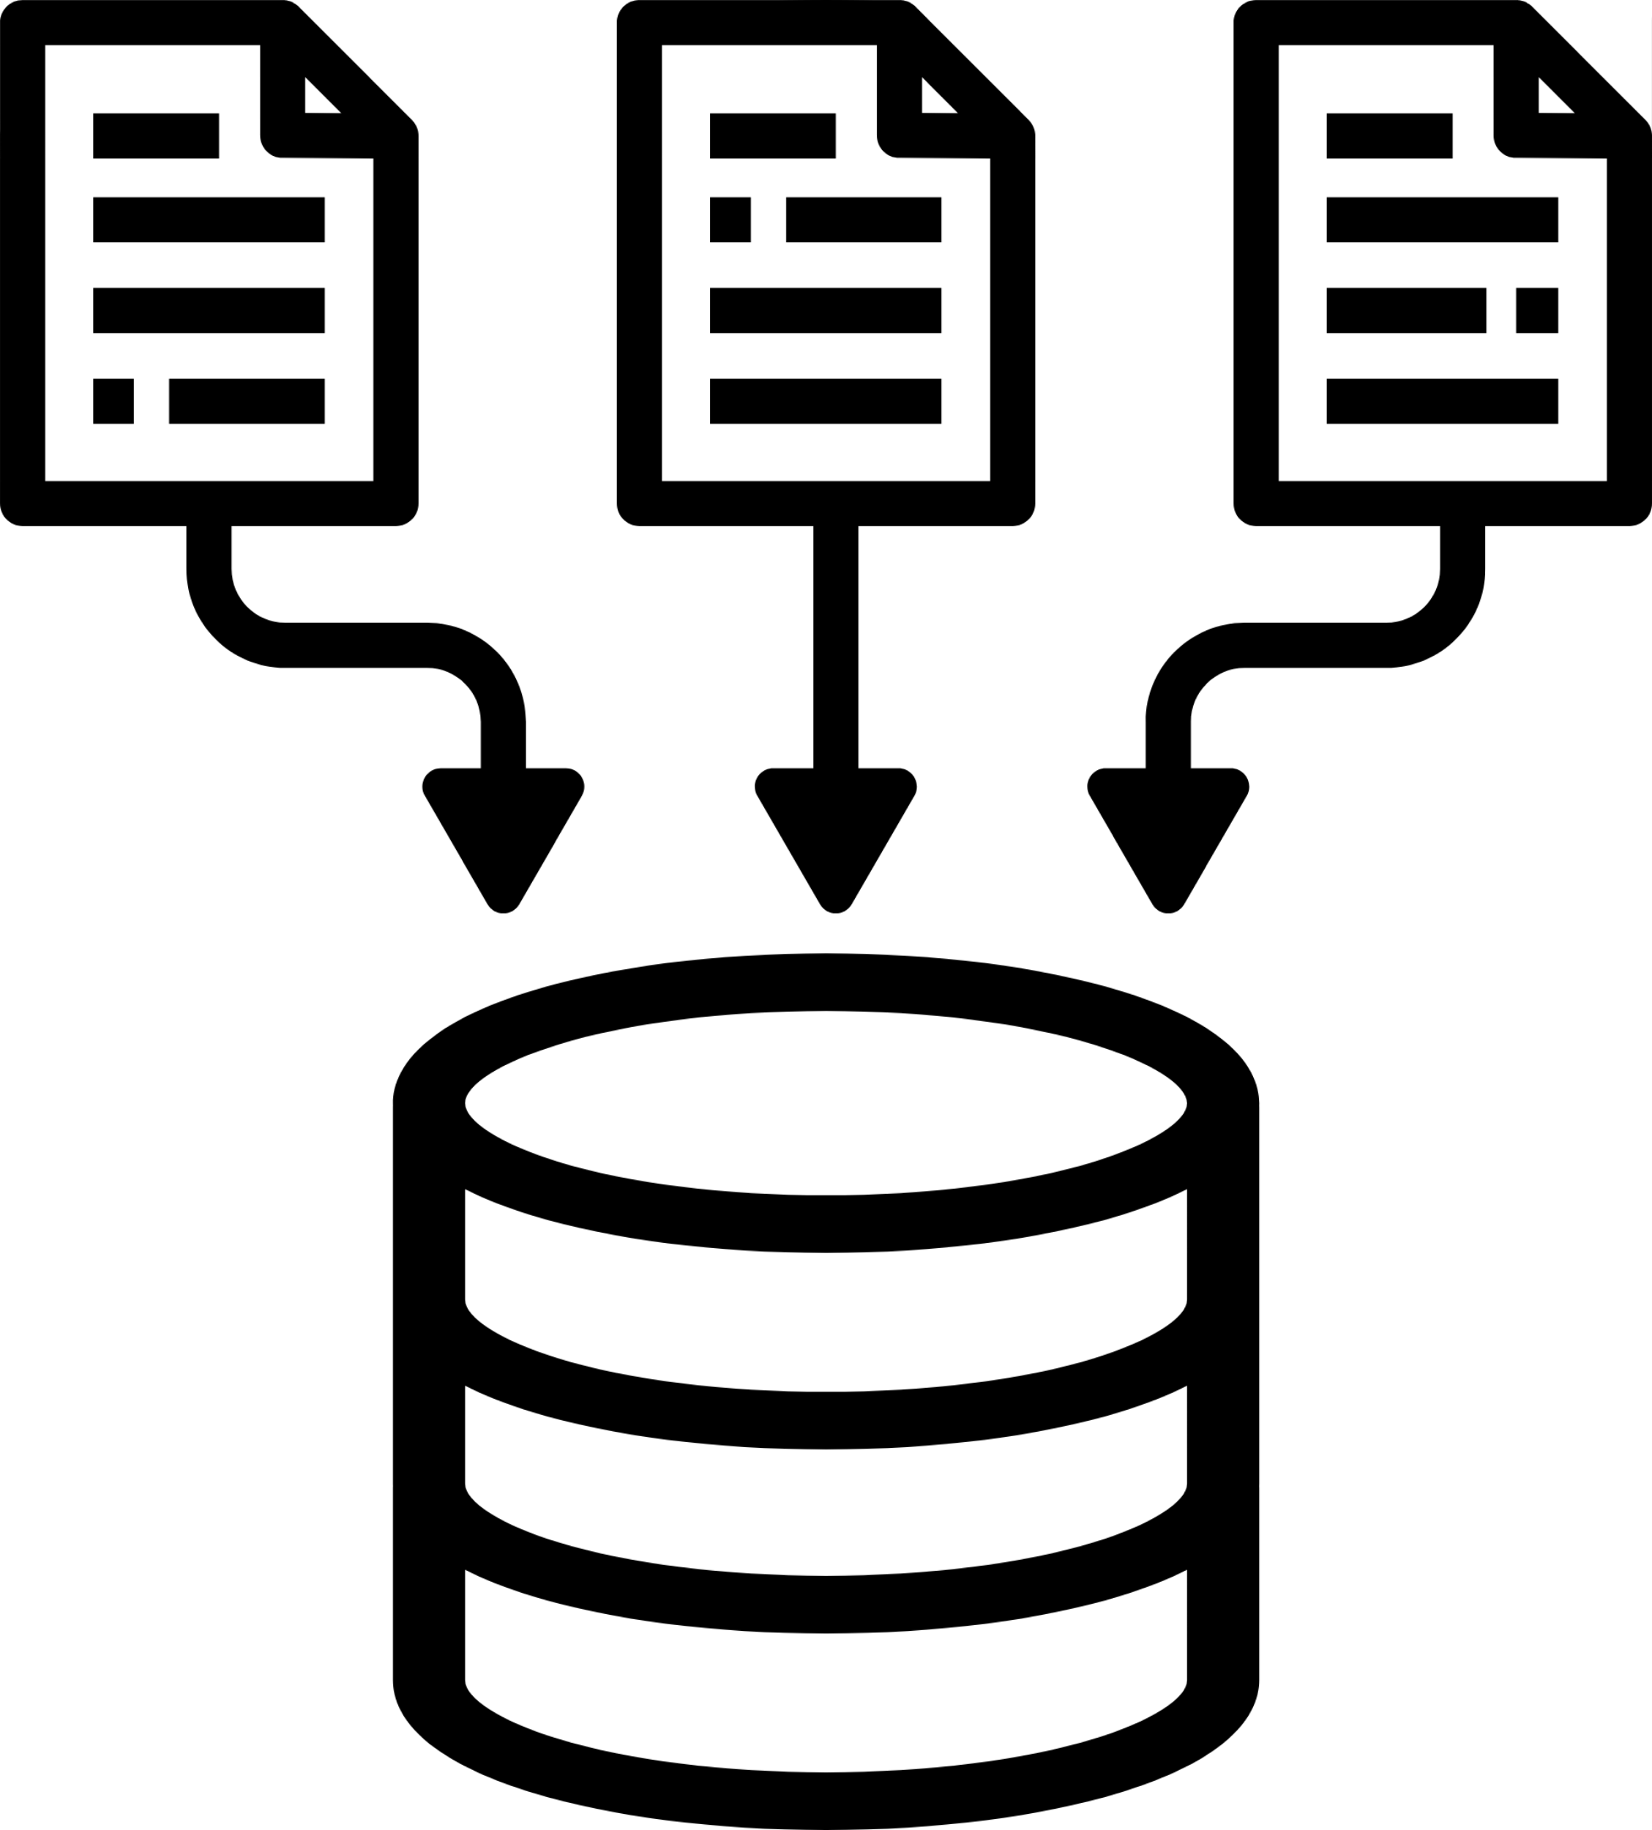
DATA CLEANING & EXPLORATORY DATA ANALYSIS (EDA)

Slide 2
TEAM
Mohammed Aftab Hussain
Gandaman Masoodvali
Haji Sohail Mohammed
Uday Shankar Yanamandhala
Navya Kolluri
Dhanush Dodda
Justin Yesudas

Slide 3

PROJECT OVERVIEW
Objective
01.
Transform messy multi-sheet Excel data into a clean, consistent dataset
Acknowledge the presence of competitors & potential challenges ahead
02.
•Provide recommendations for improving data quality
03.

Slide 4
CHALLENGES IN RAW DATA
Inconsistent column names across sheets
Misclassified fields (dates vs. IDs/text)
High missing values in several columns
Duplicate records present

Slide 5




CLEANING STRATEGY
Standardized column names into snake_case format
Removed duplicates
Automated date parsing with safeguards
Applied critical judgment for ambiguous cases

Slide 6
DATA TRANSFORMATION WORKFLOW
Load Excel sheets into unified DataFrame
Standardize columns & parse dates
Remove duplicates
Conduct EDA with visualizations
Export clean dataset

Slide 7
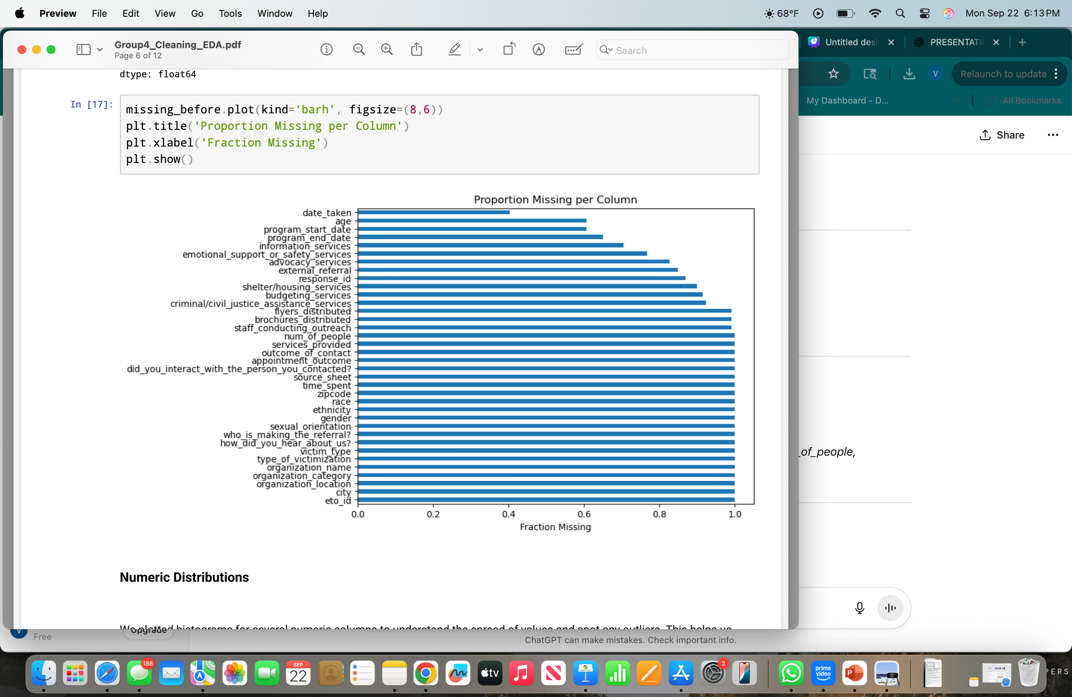
MISSING DATA ANALYSIS
Several fields had >30% missing values
High missingness reduces reliability for analysis
Visualized missingness with bar charts
Fig: Bar Chart – Proportion Missing per Column

Slide 8
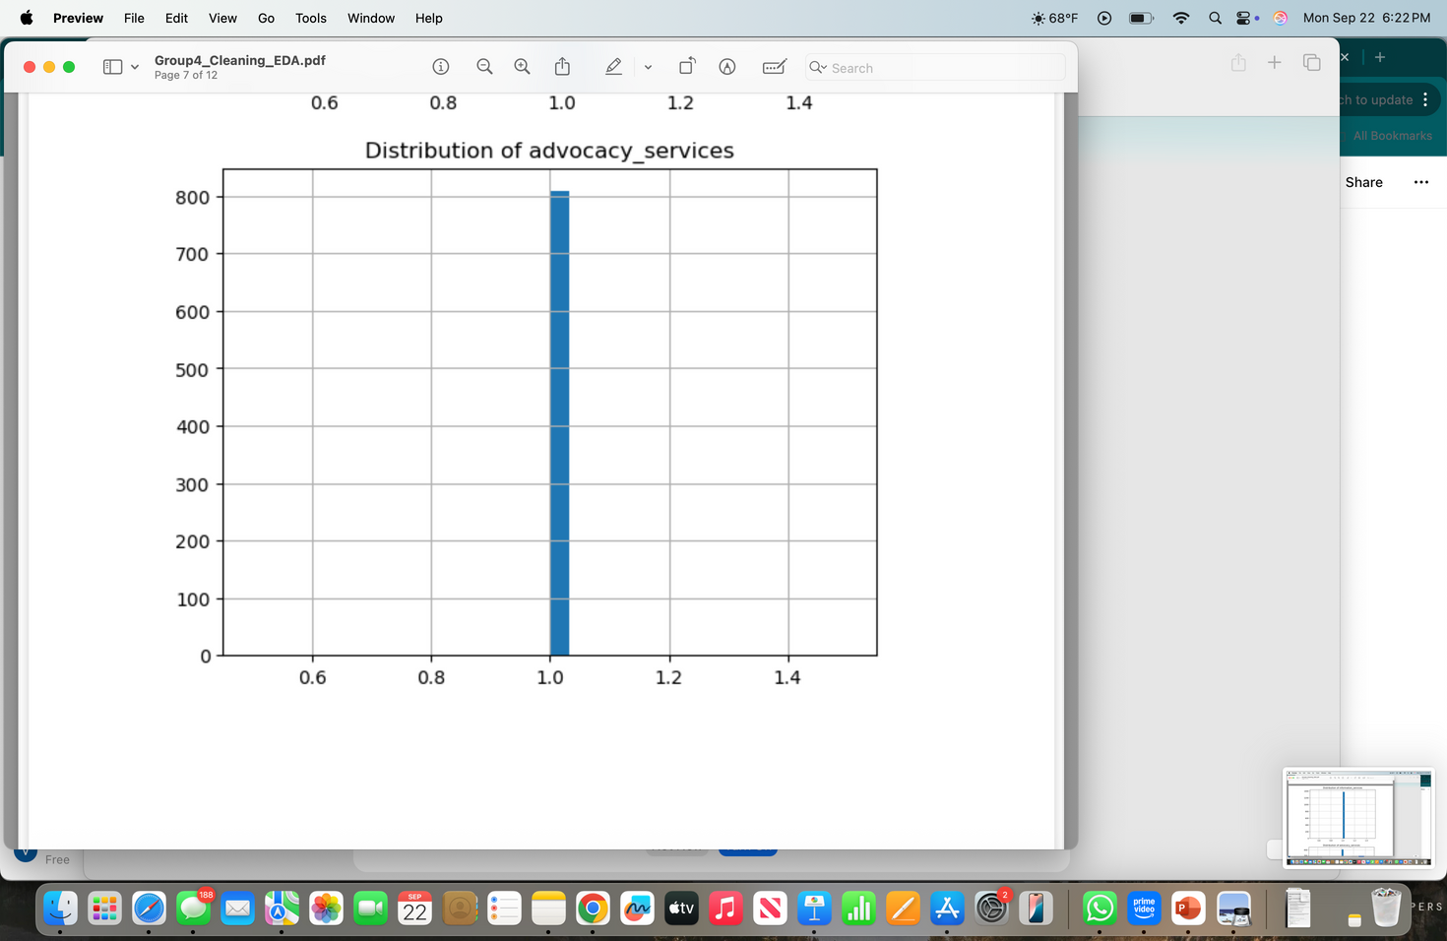
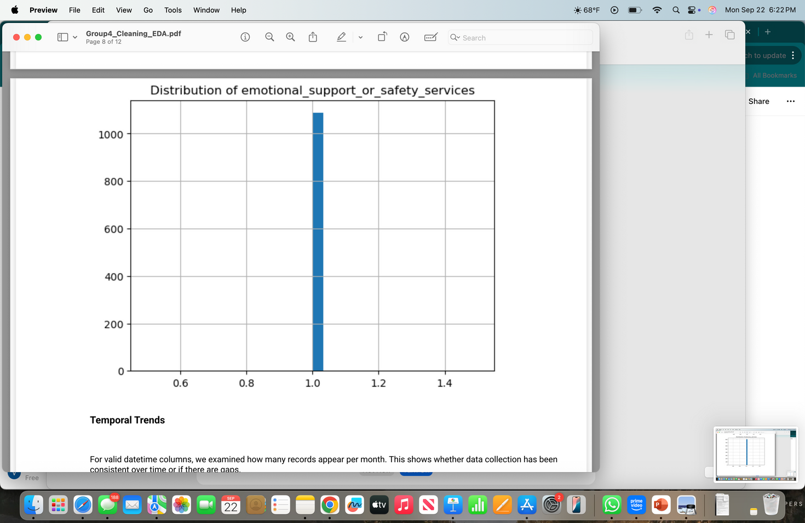
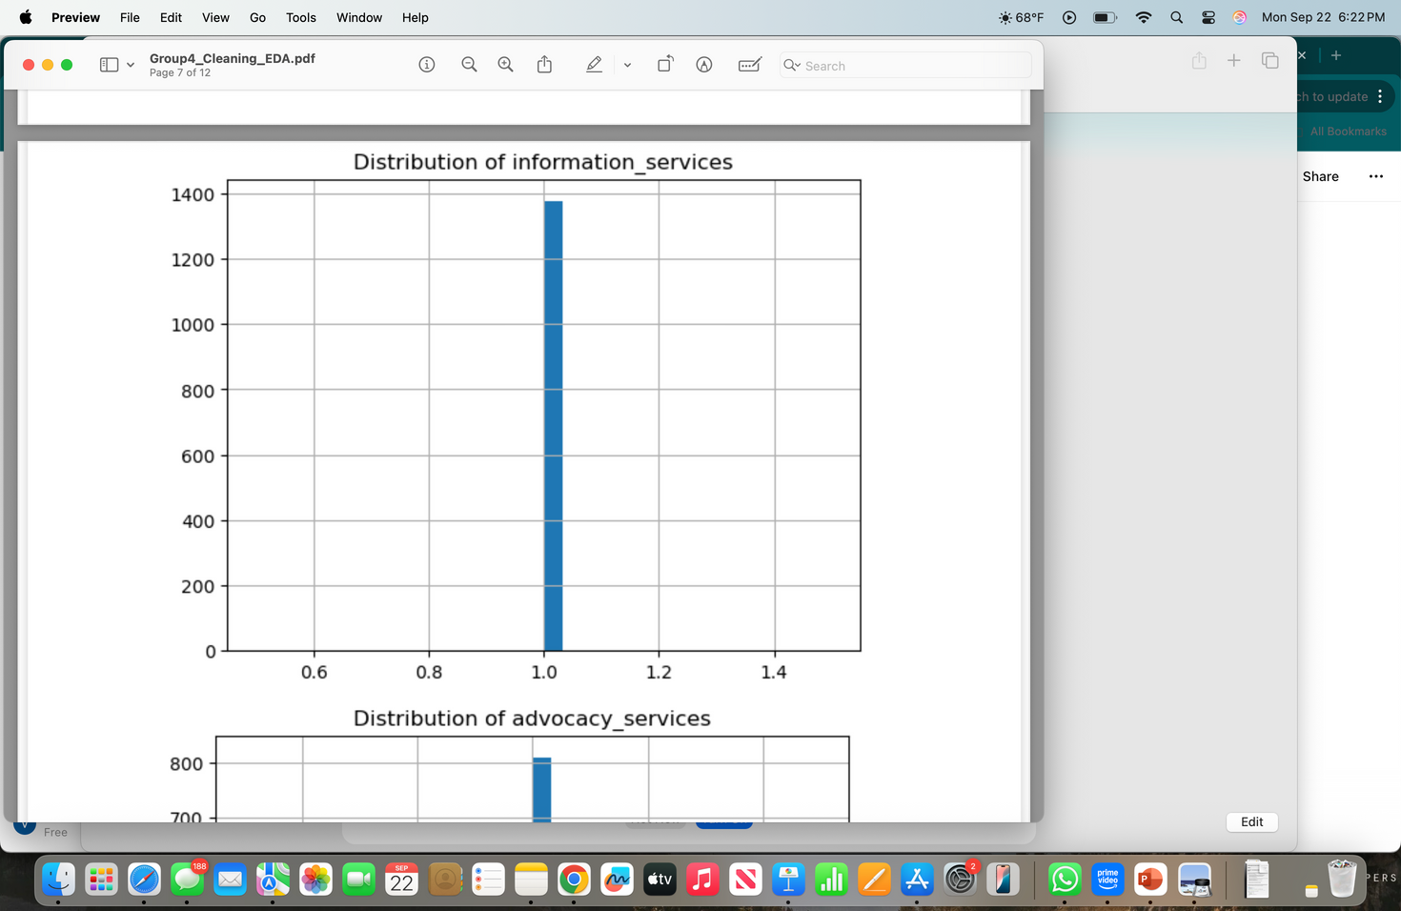
NUMERIC DISTRIBUTIONS
Histograms of numeric columns
Identified outliers and skewed distributions

Slide 9
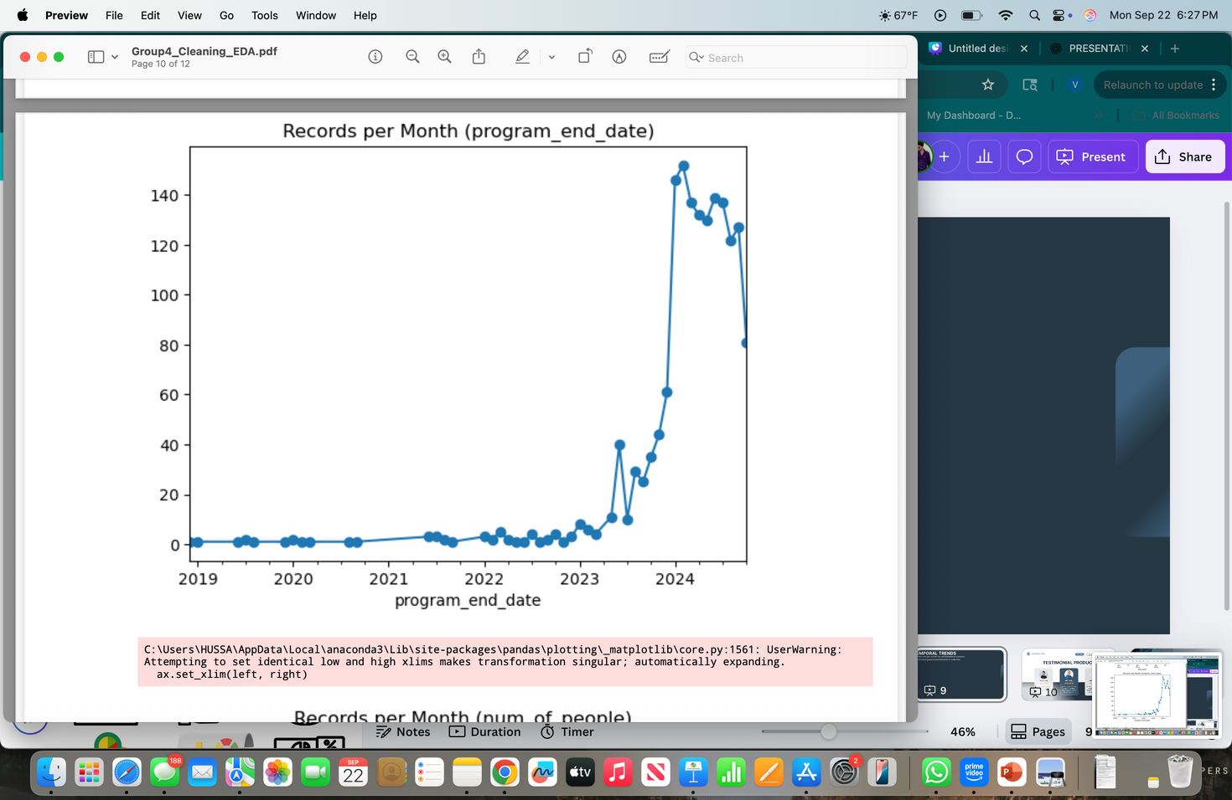
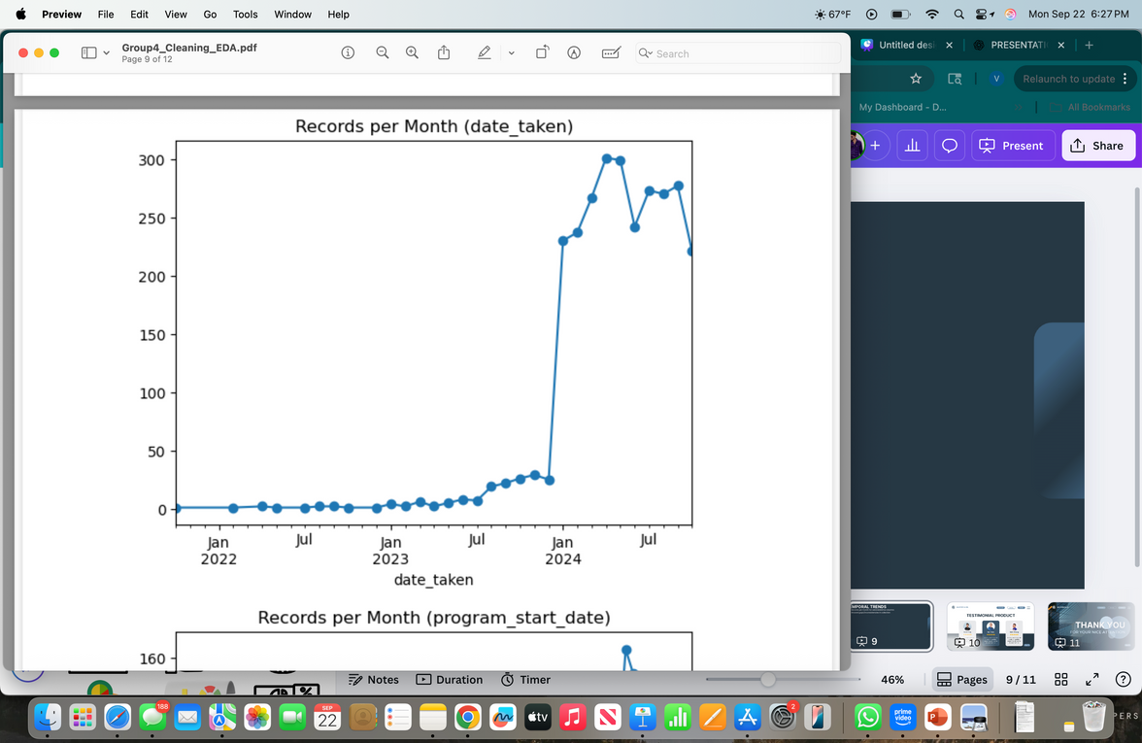
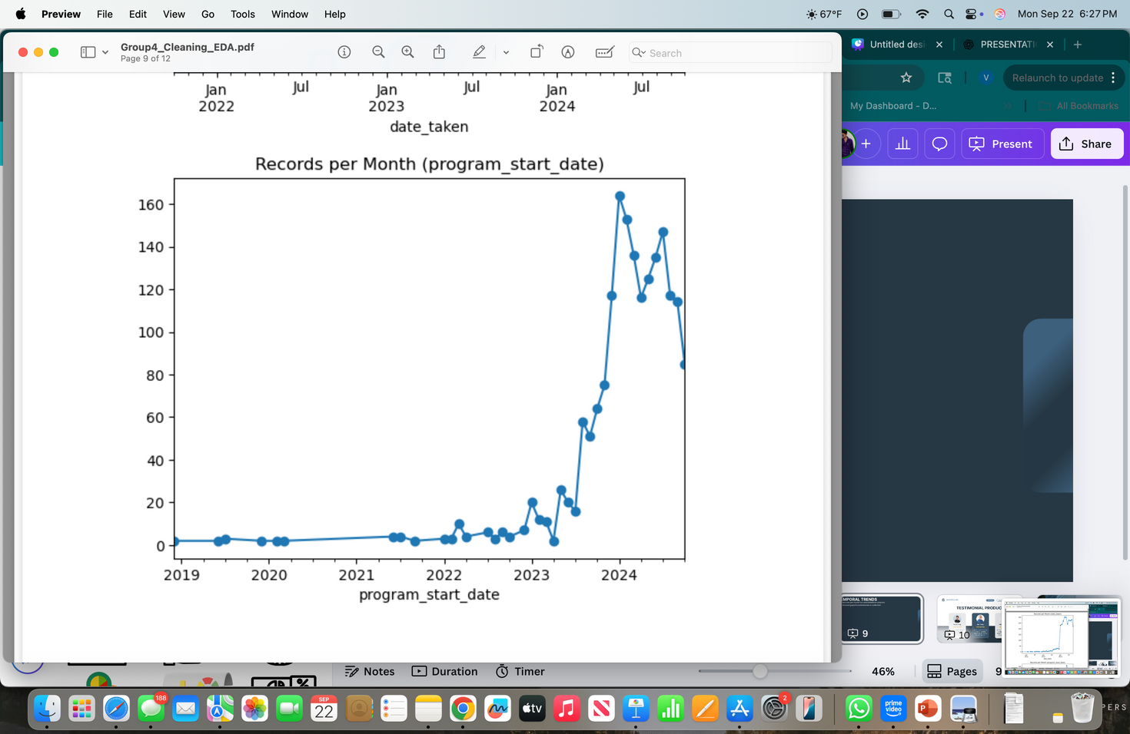
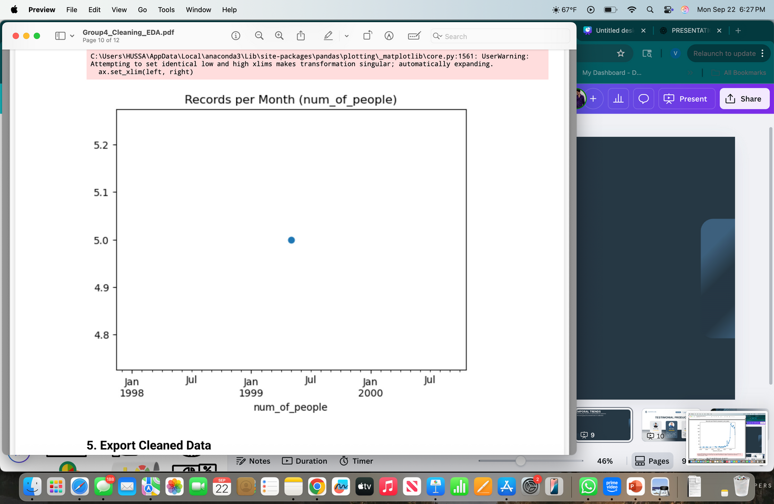
TEMPORAL TRENDS
Records per month for valid datetime columns
Showed gaps/inconsistencies in collection

Slide 10
High missingness in critical columns
Inconsistent categorical labels
Duplicate records identified and removed
Misclassified date fields caused parsing issues
Column naming variations across sheets
KEY
FINDINGS

Slide 11
RECOMMENDATIONS
Reduce missingness at source (mandatory fields)
Standardize categorical inputs with dropdowns/codebooks
Prevent duplicates with unique identifiers
Adopt ISO 8601 date standards
Use consistent naming conventions (snake_case)

Slide 12
CONCLUSION
Systematic cleaning transformed messy raw data into reliable dataset
EDA revealed gaps, trends, and anomalies
Recommendations aim to strengthen data collection and reliability
Improved dataset enables faster, more accurate future analyses

Slide 13

THANK YOU

